Slide 1
My Objectives for this Intern
Data collection of participant driver’s gaze, physiological, and kinematic parameters based on field operation tests at TiHAN CAV testbed.
Gaze data extraction and analysis utilising Imotions software and other coding approaches.
Data analysis of driver perception data, collected using questionnaire surveys.

Slide 2
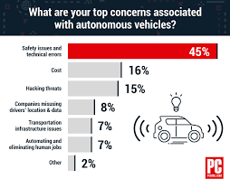

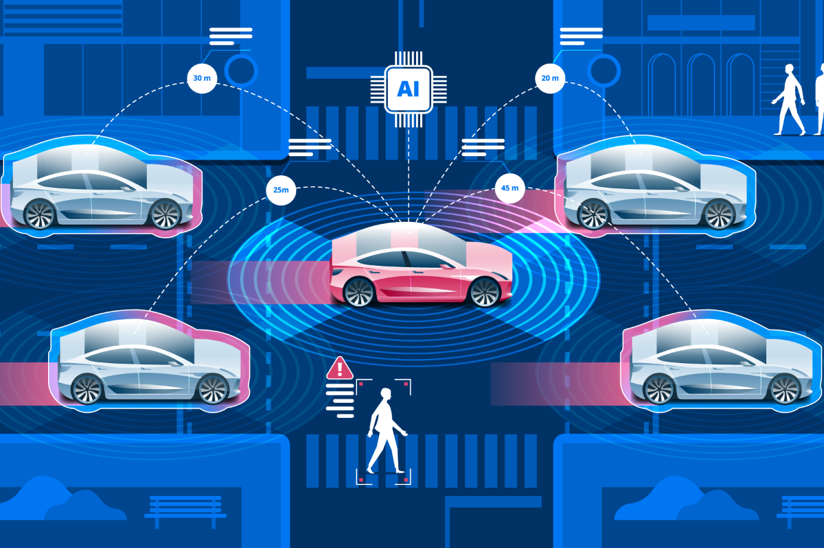
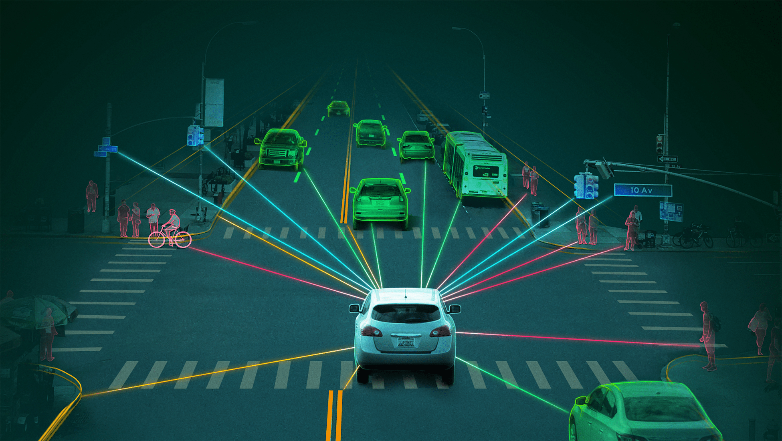
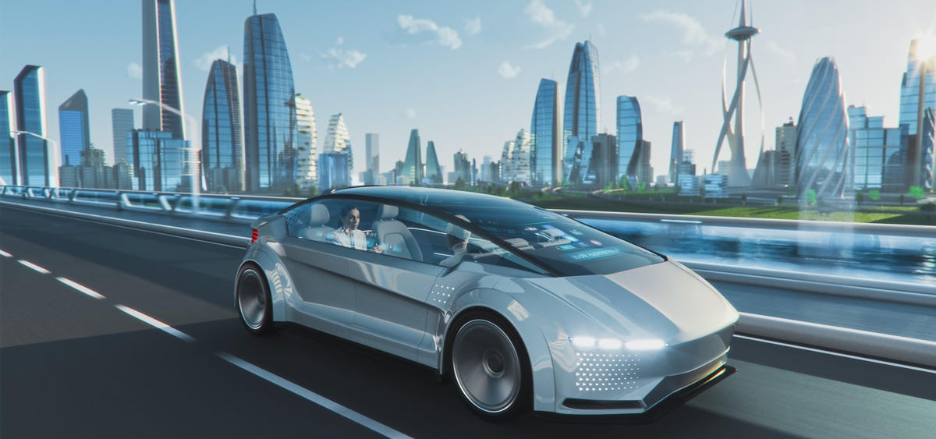
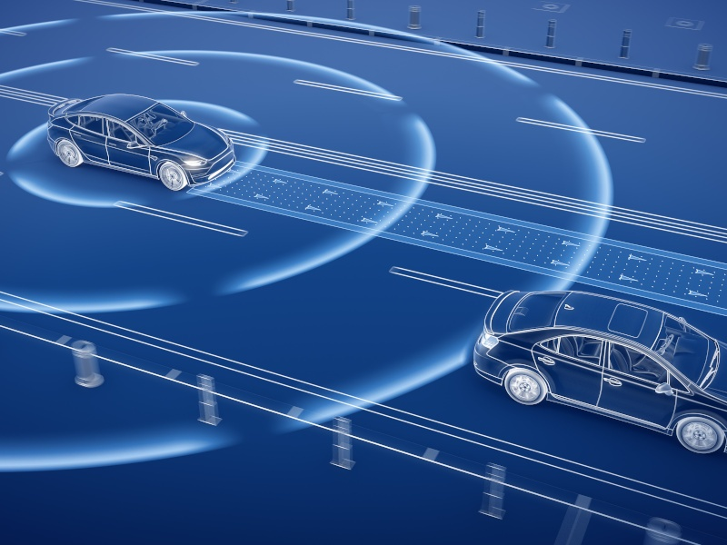
Questionnaire Analysis
Perception survey regarding USE OF AUTONOMOUS VEHICLES in campus

Slide 3
Number Assigned Responses from Survey
Response0=What is your gender identity?
Response1=Age Group
Response2 =Highest qualification/pursuing degree type
Response3= How familiar are you with autonomous vehicles (AV)?
Response4=Have you ever taken a ride in an AV (that has self-driving features)
Response5=Select one statement representing your perception on the safety of AV.
Response6=How comfortable are you with the idea of riding in an AV?
Response7=Have you ever met with an accident, caused due to human error?
Response8=Do you think AV can eliminate the human errors causing vehicle accidents.
Response9=What is the total time on average that you spend traveling on campus buses/EV in a day?
Response11=How much do you trust the technology used in AV to be reliable?
Response12=I have concerns about the possibility of accidents between regular cars and AV.
Response13=I have concerns about securing the autonomous driving system from computer hackers.
Response14=I have concerns about the performance of AV in harsh environmental conditions (such as during raining weather condition)
Response15=Overall, after considering advantages & disadvantages of using AV, would you like to commute in an autonomous vehicle in-place of campus buses?

Slide 4
Division of variables on basis of controllability
Dependent Variables
Response3
Response5
Response6
Response8
Response10
Response11
Response12
Response13
Response14
Independent Variables(Categorical)
Response0
Response1
Response4
Response7
Response15

Slide 5
One-Way ANOVA analysis
NOTE
Alpha Value = 0.05
Results:
Response 4 [F(1,95)=4.912, η_{p} ² = 0.0491, p=0.0291] and Response15 [F(1,95)=7.017, η_{p} ² = 0.0687, p=0.00946] is statistically significant to Response5
Response 15[F(1,95)=15.24 , η_{p} ² = 0.1382 ,p=0.00177] and Response7 [F(1,95)=3.926 , η_{p} ² = 0.0396 ,p=0.0504] is statistically significant to Response8
Response 15 [F(1,95)=28.72 , η_{p} ² = 0.232 ,p=5.85e-07] is statically statistically to Response11
Response 15 [F(1,95)=11.41 , η_{p} ² = 0.1071 ,p=0.00106] is statically statistically to Response12
Response 4 [F(1,95)=4.504, η_{p} ² = 0.04526 ,p=0.0364] and Response15 [F(1,95)=3.682 , η_{p} ² = 0.0373 ,p=0.058] is statistically significant to Response14
Two-Way ANOVA analysis
Results:
Interaction of Response 4 and Response 15 combined (Response4*Response15)(p=0.029,p=0.00817) is statistically significant to Response 5

Slide 6
Conclusions:
People who have taken ride in AV have higher mean rating of safety than people who have not.
People who would like to use AV services in campus have higher mean rating of safety than people who would not like.
People who would like to use AV services in campus have higher mean of rating of trust in AV’s for eliminating human errors causing accidents than people who would not like to use.
People who have met with accidents almost equal mean of rating of trust in AV’s for eliminating human errors causing accidents to people who have not.
People who would like to use AV services in campus have higher mean rating of trust on reliability of AV than people who would not like to use.
People who would like to use AV services in campus have lower mean rating of concerns of having accidents between regular cars and AVs than people who would not like to use.
People who would like to use AV services in campus have lower mean rating of concerns of performance of AV in harsh environmental conditions than people who would not like to use.
People who have taken ride in AV have higher mean rating of concerns of performance of AV in harsh environmental conditions than people who have not taken ride.

Slide 7
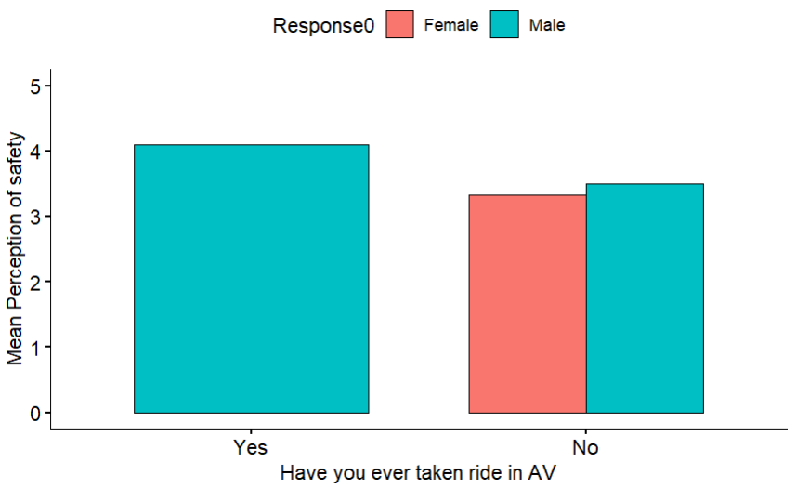
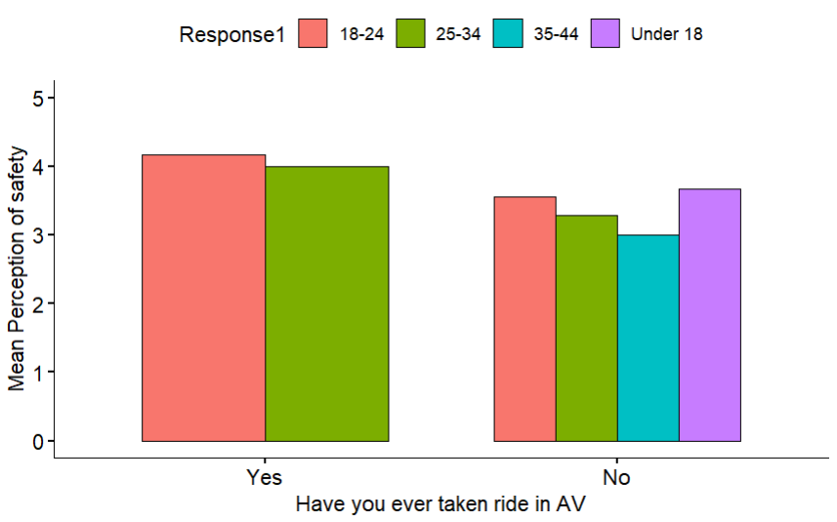
Results for supporting Conclusion 1

Slide 8
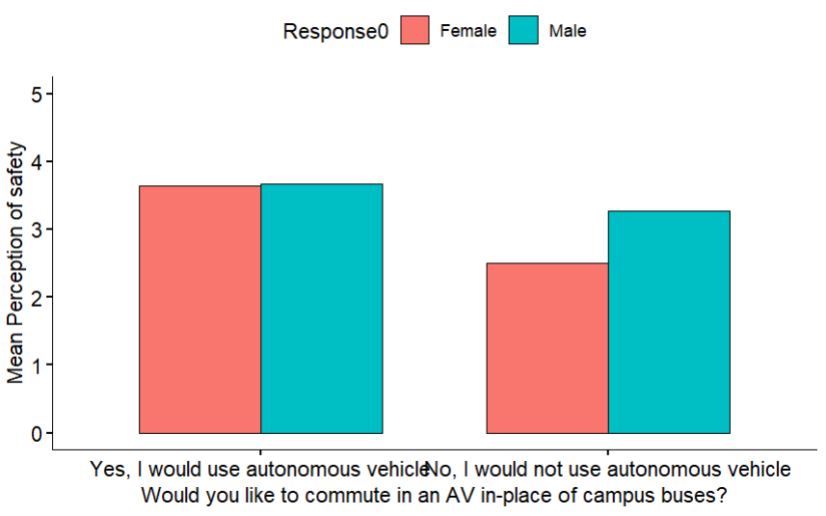
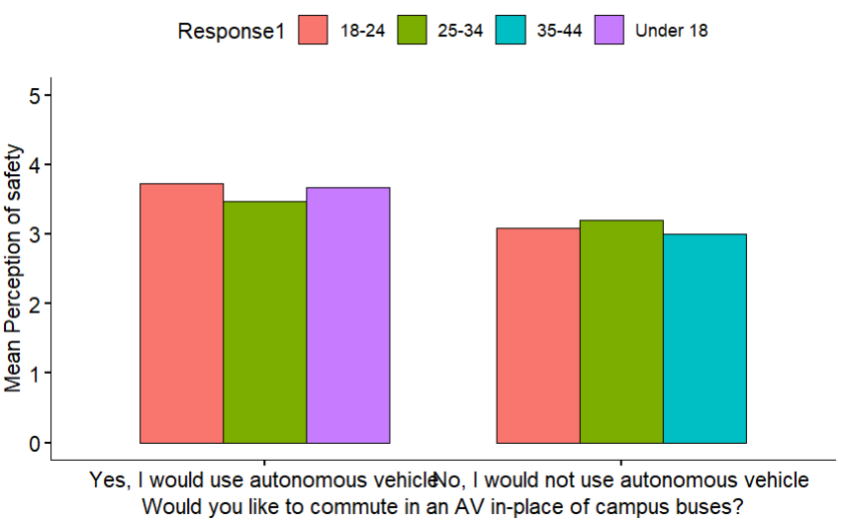
Results for supporting Conclusion 2

Slide 9
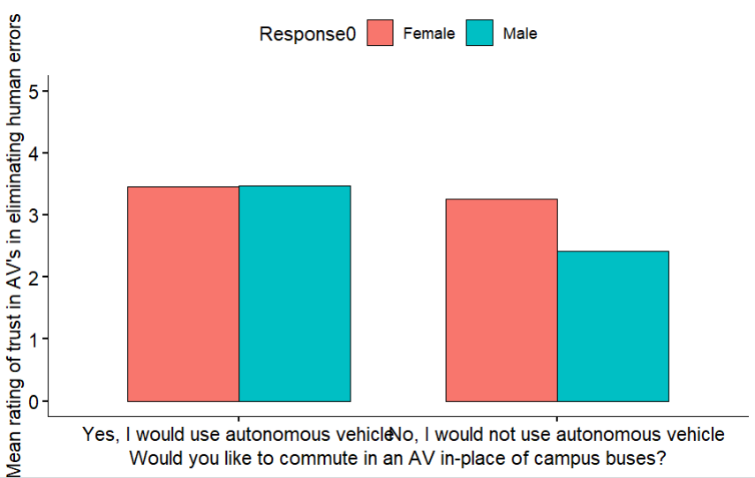
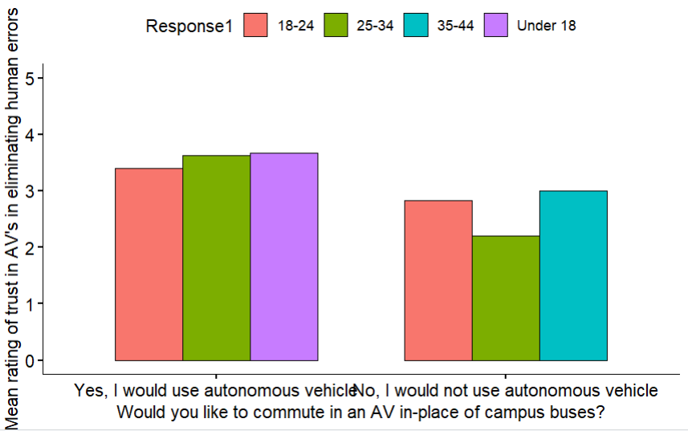
Results for supporting Conclusion 3

Slide 10
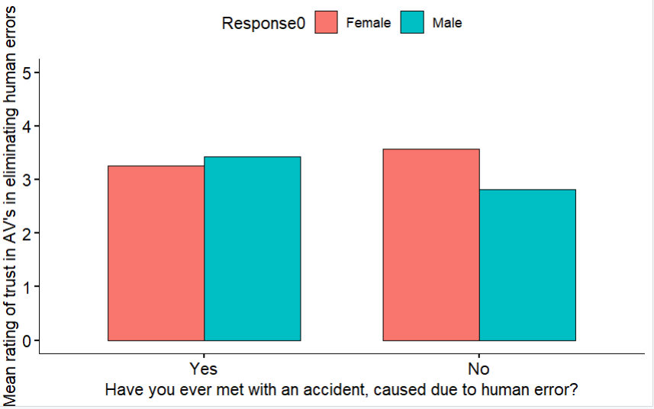
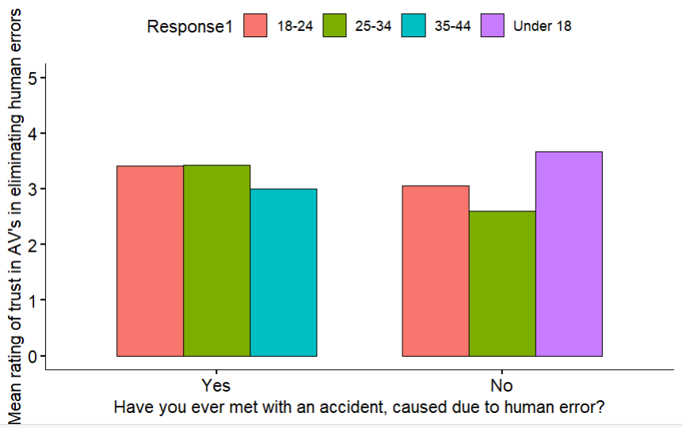
Results for supporting Conclusion 4

Slide 11
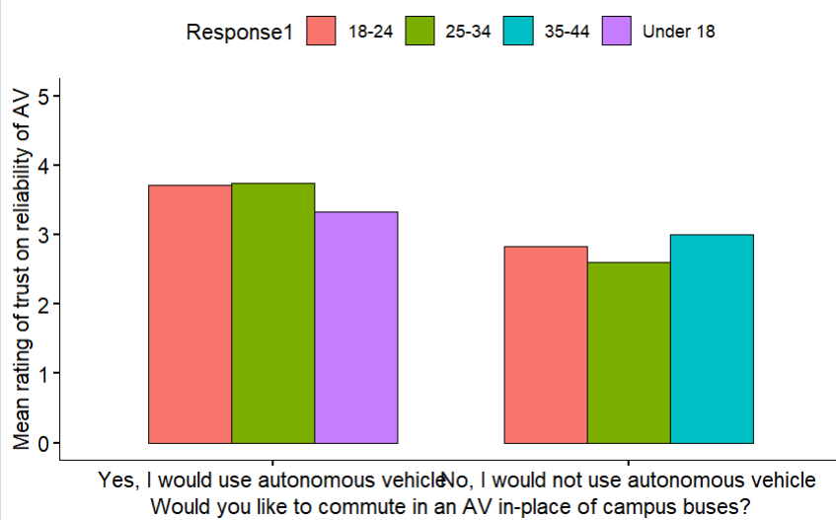
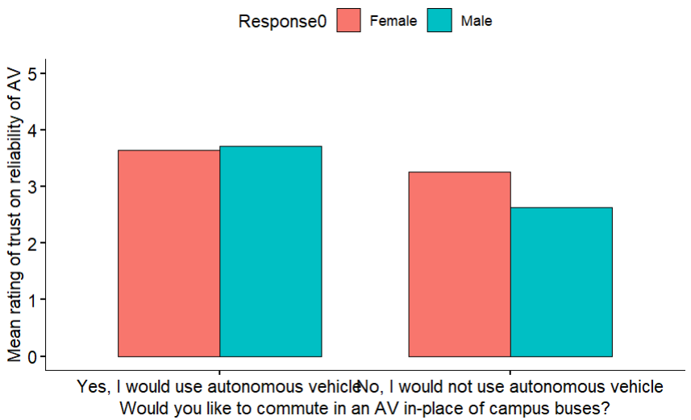
Results for supporting Conclusion 5

Slide 12
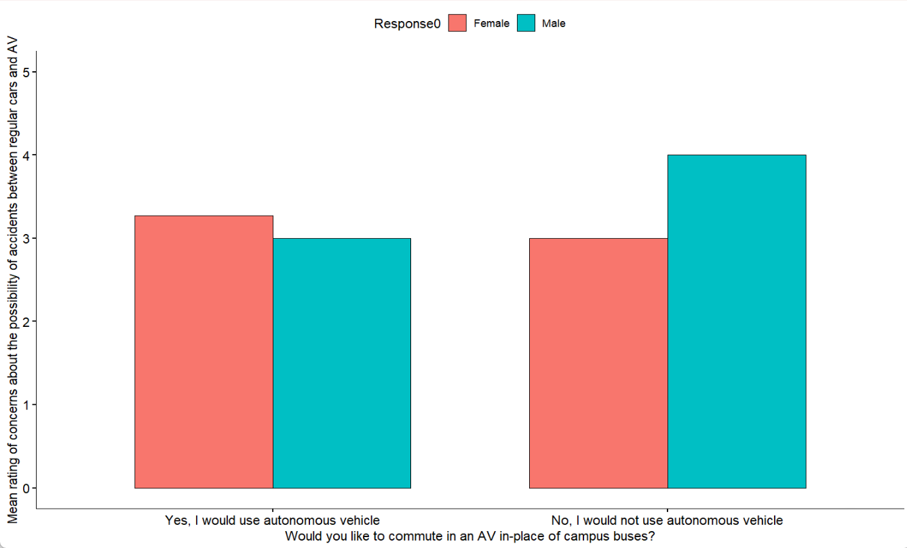
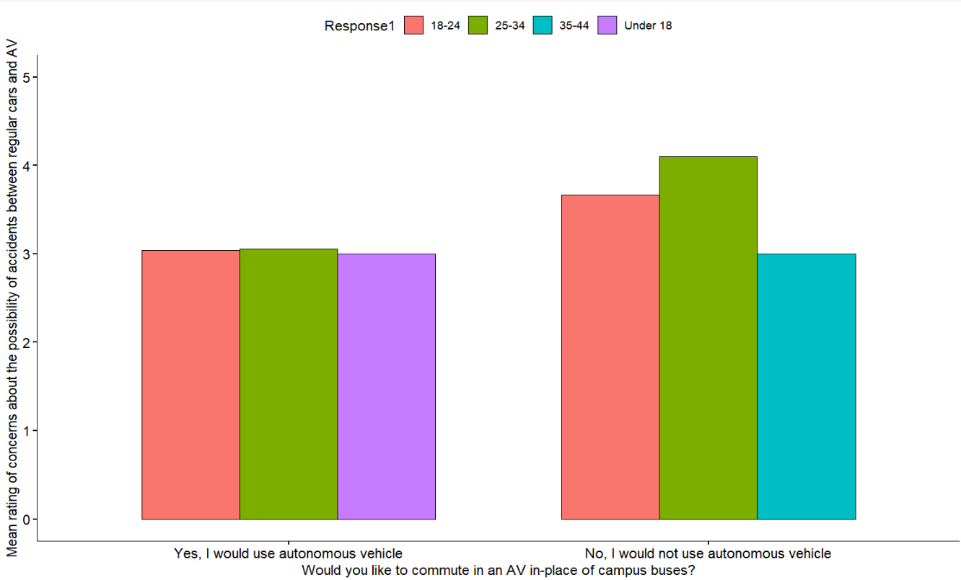
Results for supporting Conclusion 6

Slide 13
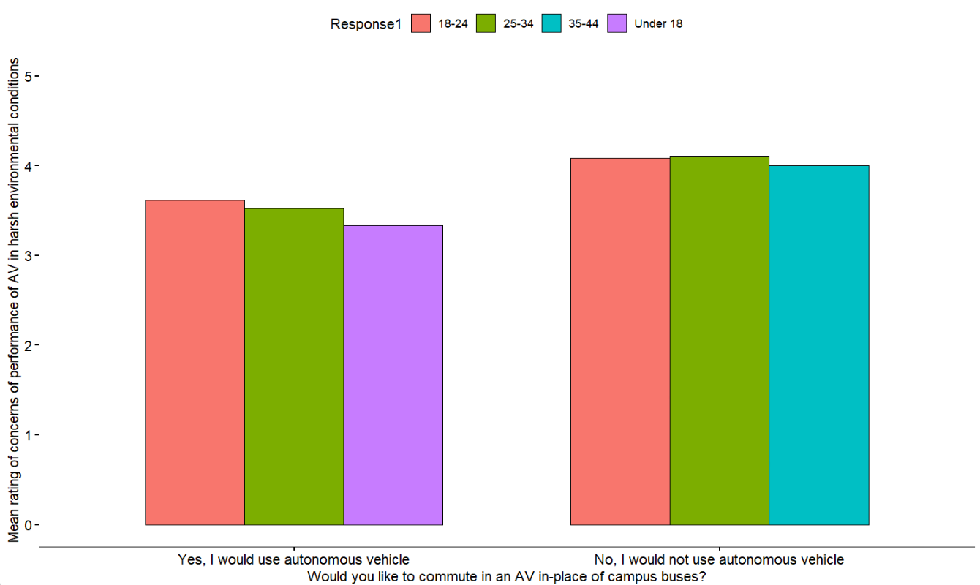
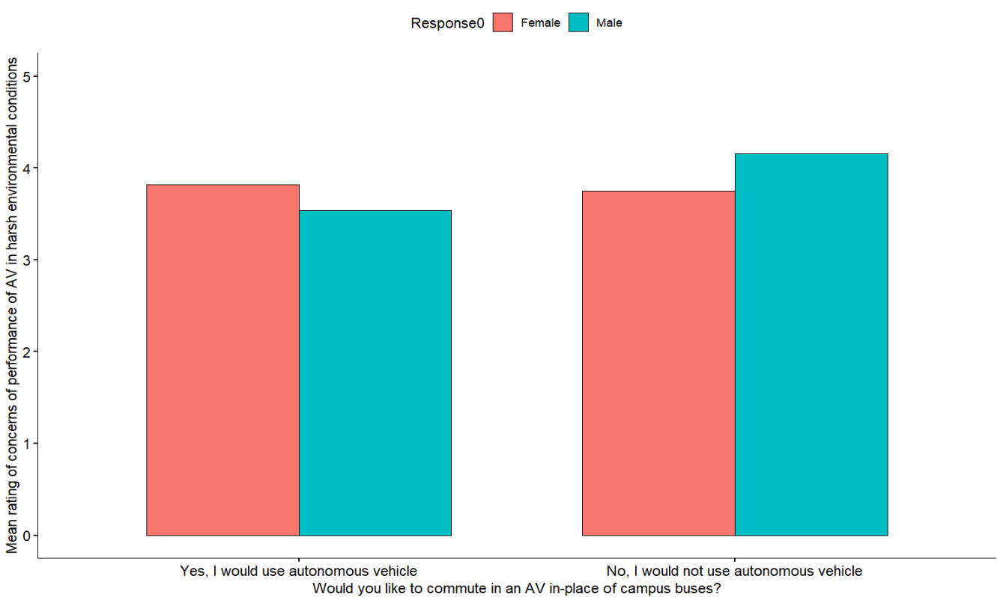
Results for supporting Conclusion 7

Slide 14
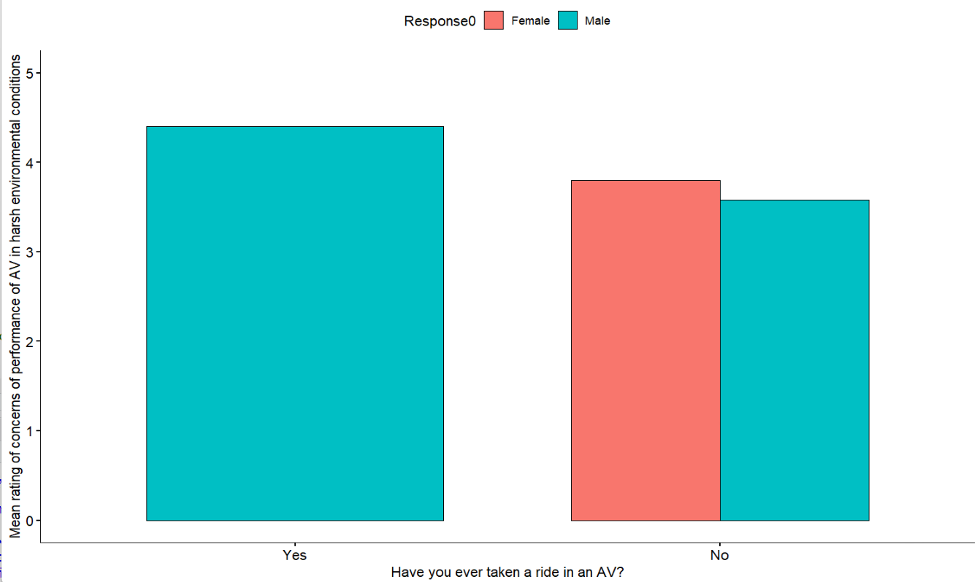
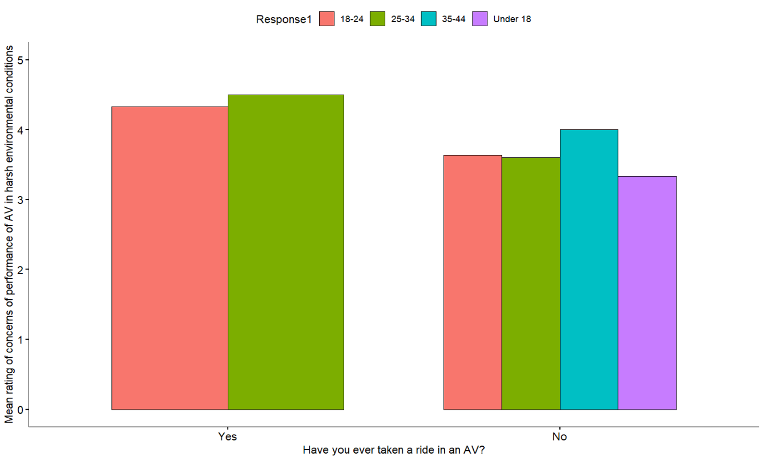
Results for supporting Conclusion 8

Slide 15
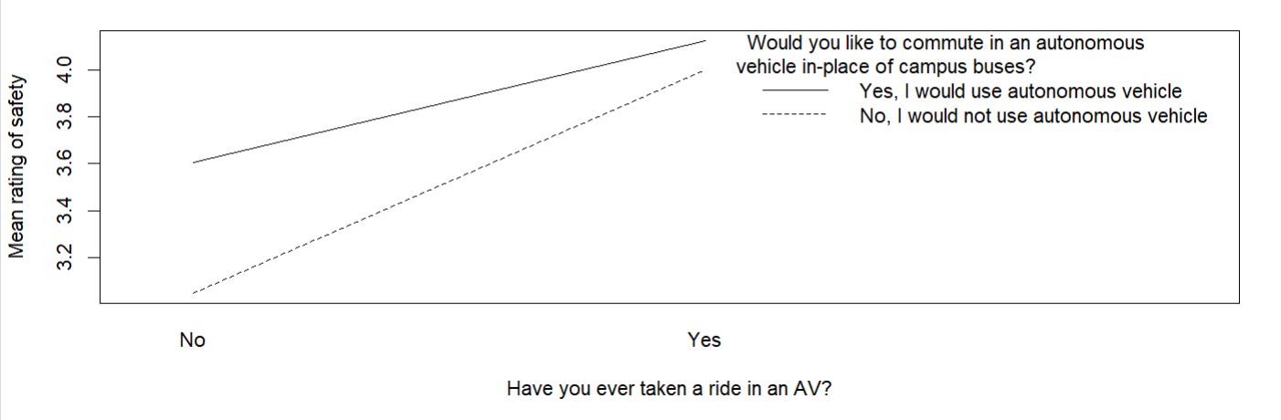
Two-way ANOVA interaction plots

